Slide 1
Wireless Lighting System

Slide 2
Aim of the Project
The aim of this project is to design and implement a wireless lighting system that will be used at homes, offices and industries.
It is a remote controlled AC bulb.
The project can be used by people with disabilities, people who are not able to step on a wall switch and those who have low access to switches at a distance.

Slide 3
Components involved
Arduino UNO R3 Board
Relay
AC Bulb
IR Receiver sensor
Jumpers and connecting wires
AC power source (Socket)
Breadboard (for prototyping)

Slide 4
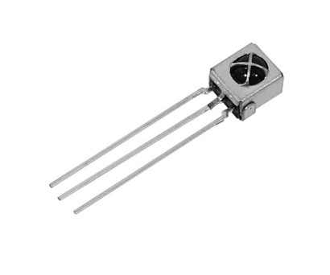
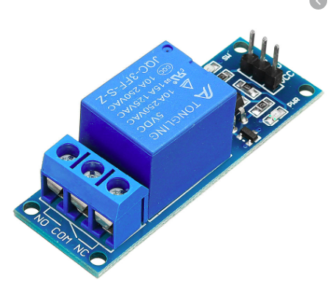
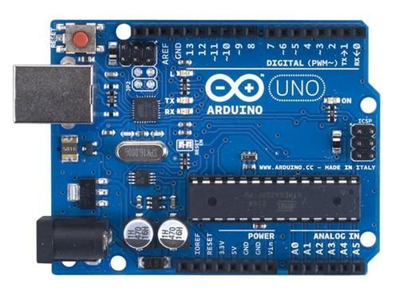
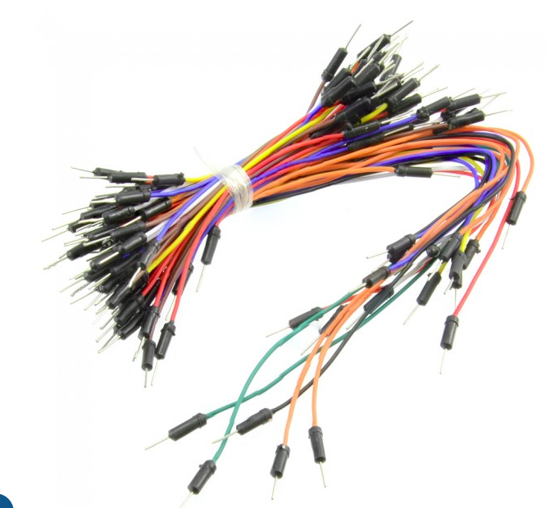
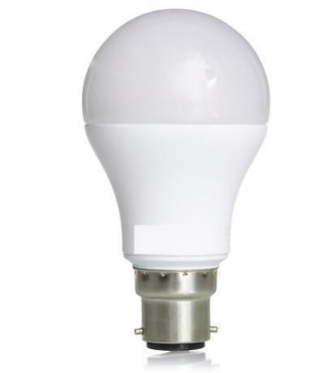
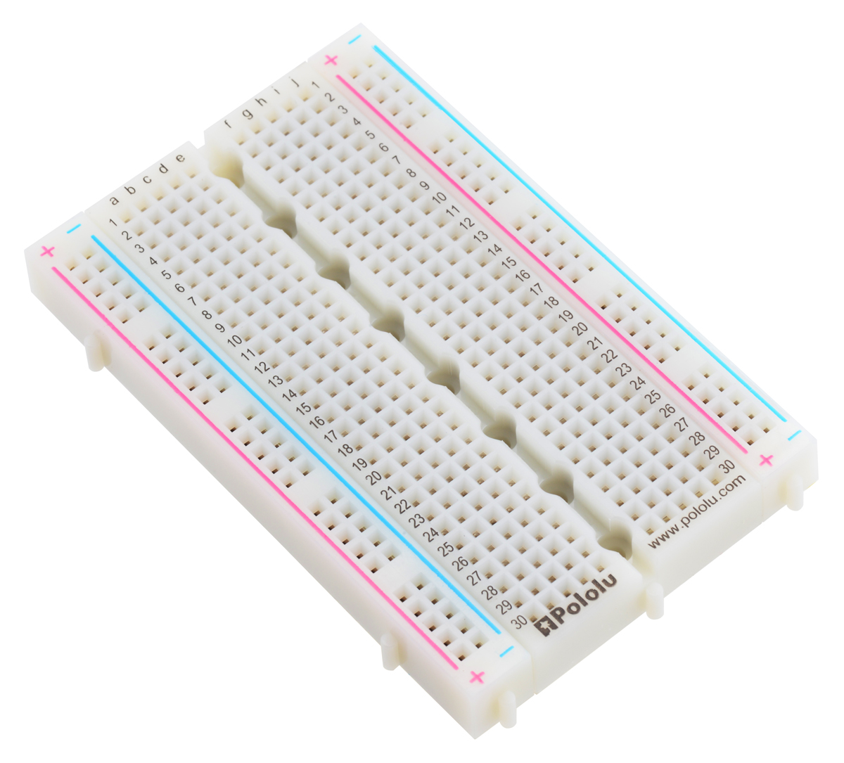
IR Receiver sensor
Relay Module (1 ch)
Arduino UNO R3 board
Jumpers
AC Bulb
Breadboard

Slide 5
Working Principle of a Relay
It works on the principle of an electromagnetic attraction.
When the circuit of the relay senses the fault current, it energises the the electromagnetic field which produces the temporary magnetic field.
This magnetic field moves the relay amarture for opening of closing the connection.

Slide 6
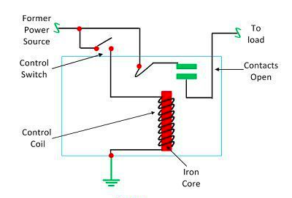

Slide 7
Working Principle of IR Receiver Sensor
IR Receiver is also called a photodiode.
The emitter is an IR LED and the detector is an IR photodiode.
The IR photodiode is sensitive to the IR light emitted by an IR LED. The photodiode's resistance and output voltage change in proportion to the IR light received.

Slide 8
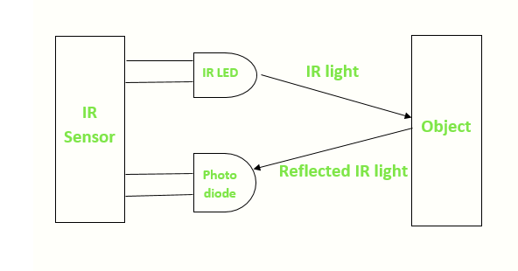

Slide 9


